Slide 1
Marketing and Retail Analytics
Submitted by : Rithesh Kamath

Slide 2
Agenda
Objective
Background
Data Preparation & Cleaning
Importing data into Visualization Tool
Data Analysis
Recommendation
Appendix:
Data Assumptions
Data Methodology

Slide 3
Objective
Our main objective is to identify list of top products that contribute to the revenue and also use market basket analysis to analyze the purchase behavior of individual customers to estimate with relative certainty, what items are more likely to be purchased individually or in combination with some other products.
We also need to identify the product categories which we can get rid of without significantly impacting business.

Slide 4
Background
OList is an e-commerce company that has faced some losses recently and they want to manage their inventory very well so as to reduce any unnecessary costs that they might be bearing.
Some of products might be fast-moving which sell very quickly while others might be slow-moving. Each of the products being stored in a warehouse incurs cost to the company in terms of space and maintenance. Since storing these products obviously add to the costs that the company incurs, it is absolutely necessary for the organizations to plan their inventory well.

Slide 5
Data Preparation and Cleaning
Filter & keep records only containing order_status = ‘delivered’ in the ‘orders’ table
Treat the missing values under the columns ‘order_approved_at’ and ‘order_delivered_timestamp’ of the ‘orders’ table with their respective ‘order_purchase_timestamp’ and ‘order_estimated_delivery_date’ values
Filter and remove duplicate customer ids from ‘customer_id’ column of the ‘customers’ table
Treat the missing values under column ‘product_category_name’ of the ‘products’ table by assigning the value ‘toys’ as 75% of the products belong to this category and the mode value for this column also turns out to be ‘toys’
Treat the missing values under the columns ‘product_weight_g’, ‘product_length_cm’, ‘product_height_cm’ and ‘product_width_cm’ with its respective median values as the data in these columns are skewed
These cleaned datasets are imported to two excel files - ‘Market_Basket_Dataset.xlsx’ (for market basket analysis) & ‘Cleaned_Retail_Dataset.xlsx’ (for all other visualizations & analysis)

Slide 6
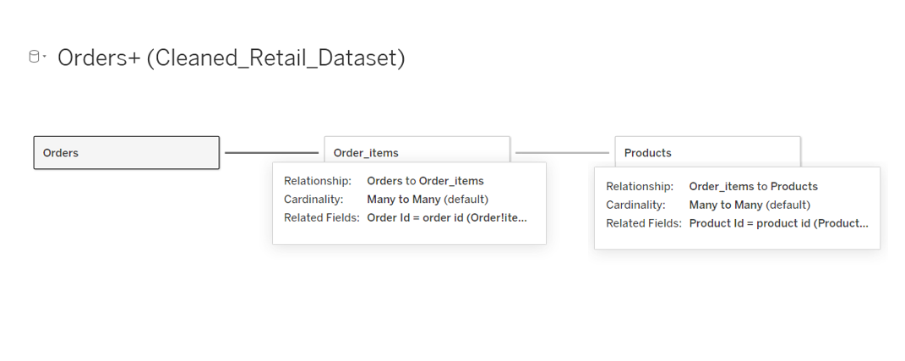
Importing data into Visualization Tool
For the analysis involving ‘Top 20 Ordered Products’, ‘Top 20 products by Revenue’ and ‘Product Category Wise orders’, we have used the excel file ‘Cleaned_Retail_Dataset.xlsx’ and the merging of data sets in tableau is done as follows:

Slide 7
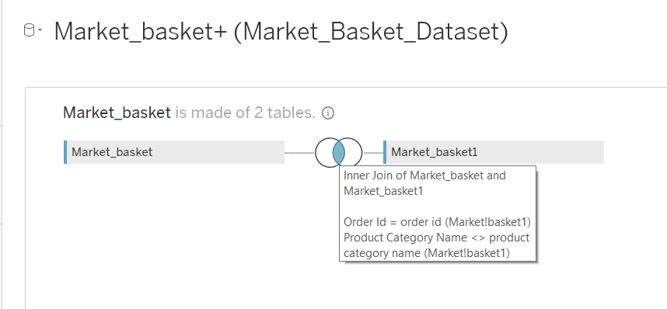
Importing data into Visualization Tool
For the analysis involving ‘Market Basket Summary’ and ‘Market Basket Category Summary’, we have used the excel file ‘Market_Basket_Dataset.xlsx’ and the self-joining in tableau is done as follows:

Slide 8
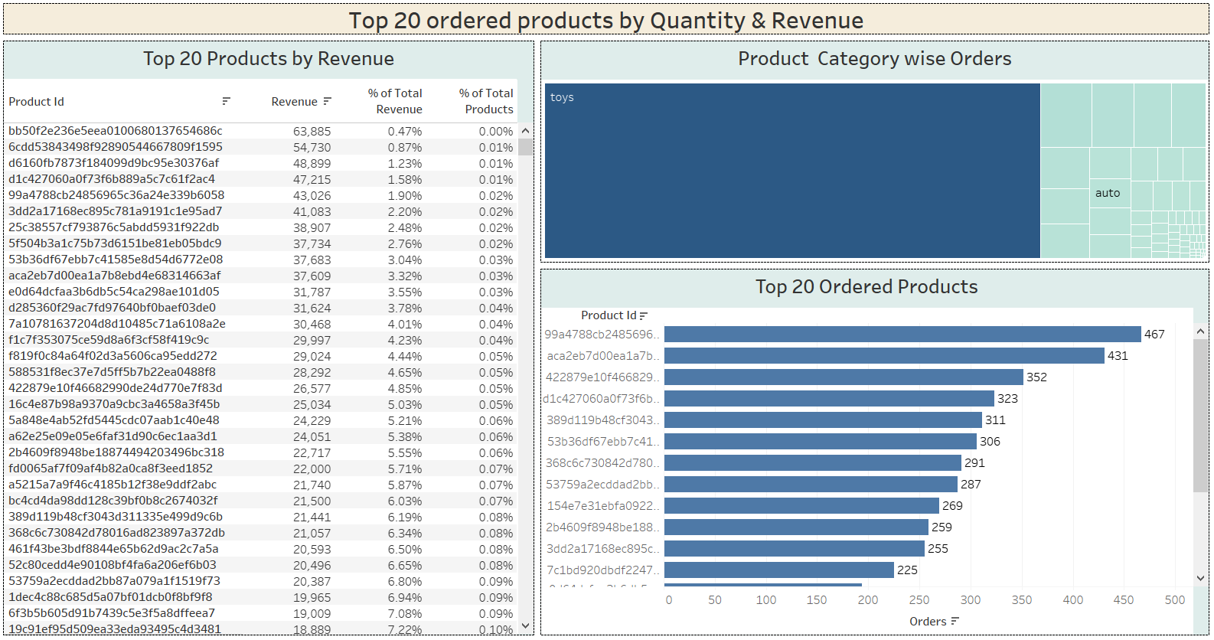
Dashboard 1: Top 20 ordered products by Quantity & Revenue
This dashboard gives the top ordered products by quantity as well as by revenue.

Slide 9
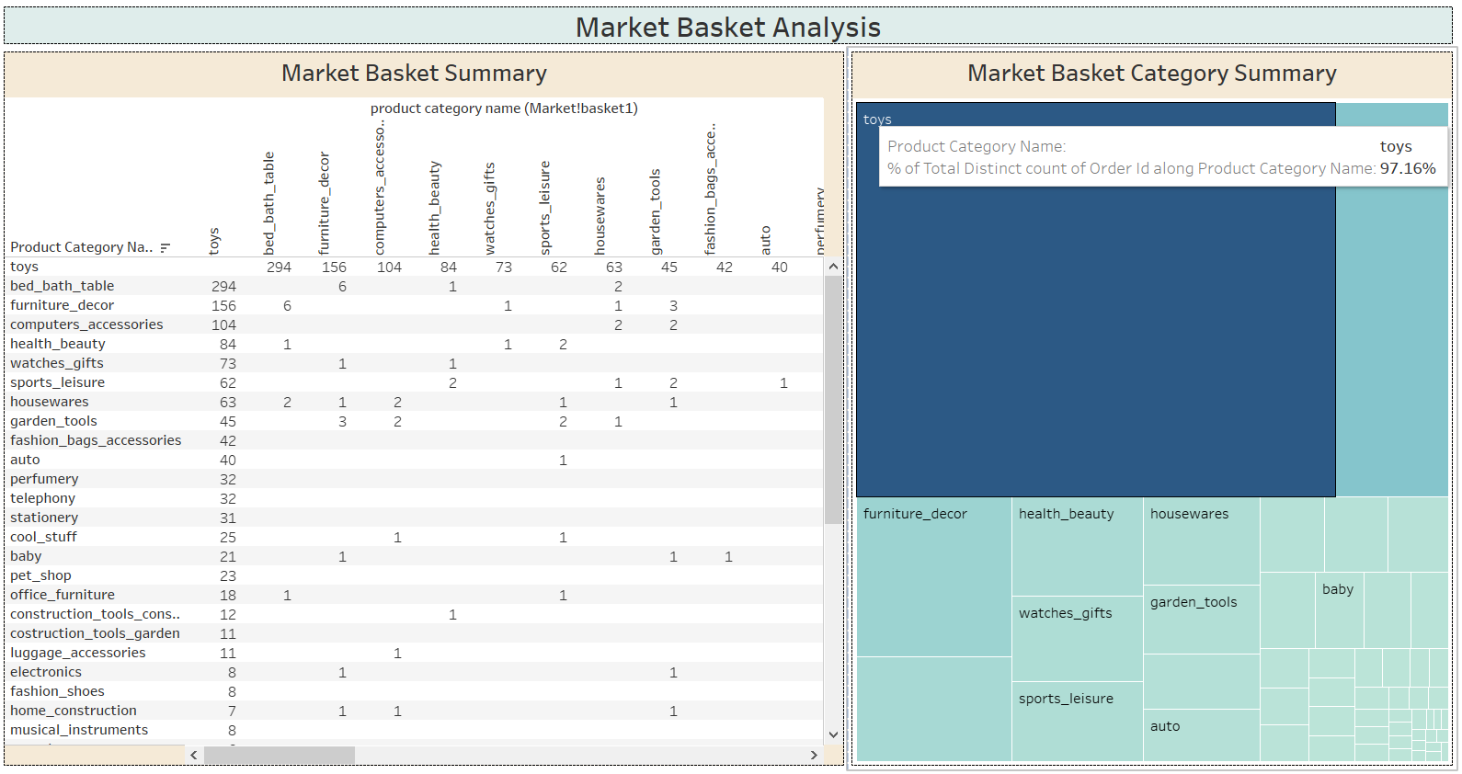
Dashboard 2: Market Basket Analysis
This dashboard gives the best combinations of product categories which are frequently ordered together

Slide 10
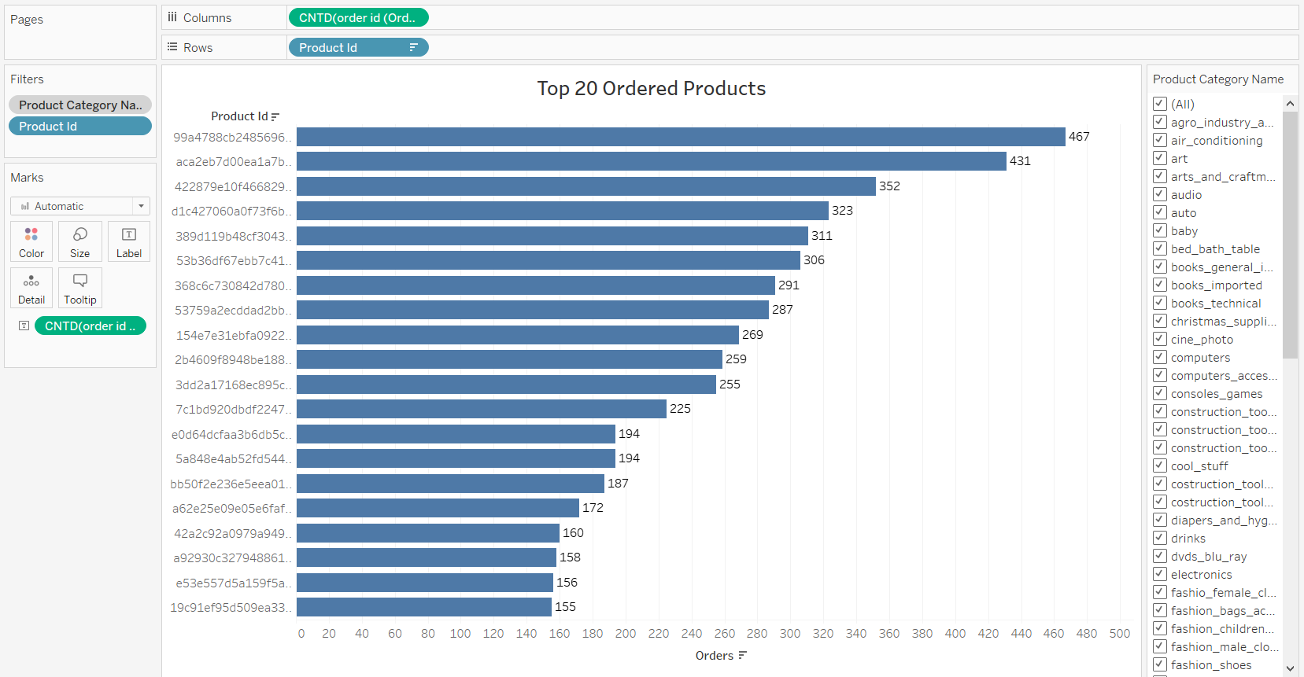
Top 20 Ordered Products
Visualizes top 20 products ordered by quantity
Using the filter on the right side, either select a specific or a group of product categories to show their top 20 ordered products by quantity

Slide 11
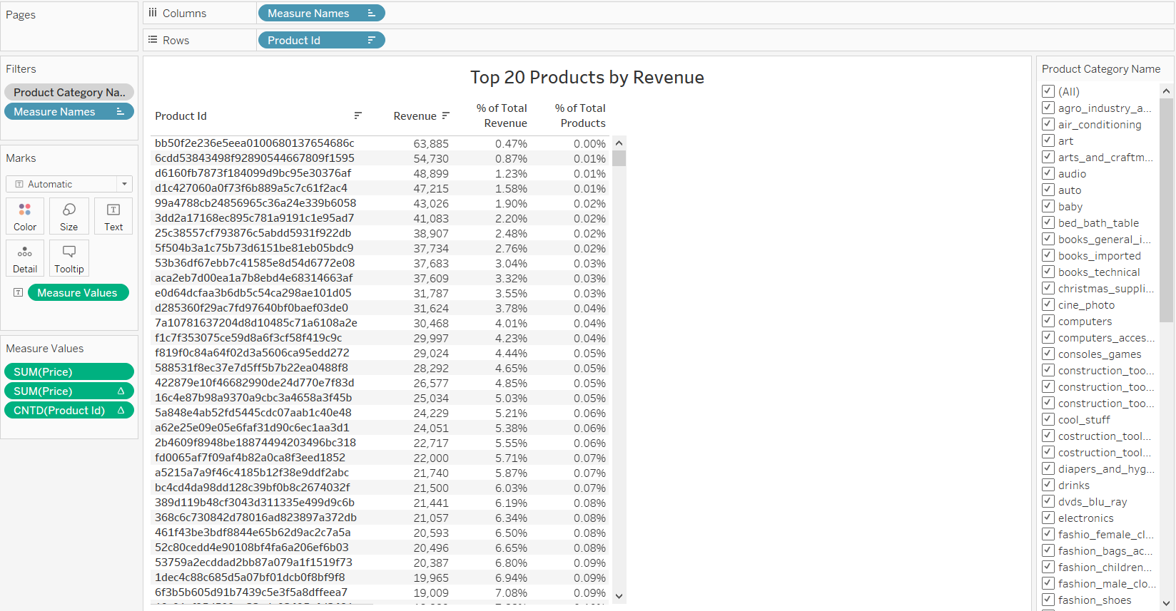
Top 20 Products by Revenue
Visualizes top products based on revenue
Using the filter on the right side, either select a specific or a group of product categories to show their top products based on revenue
The percentage running totals by revenue and by total number of orders are also depicted in this visualization

Slide 12
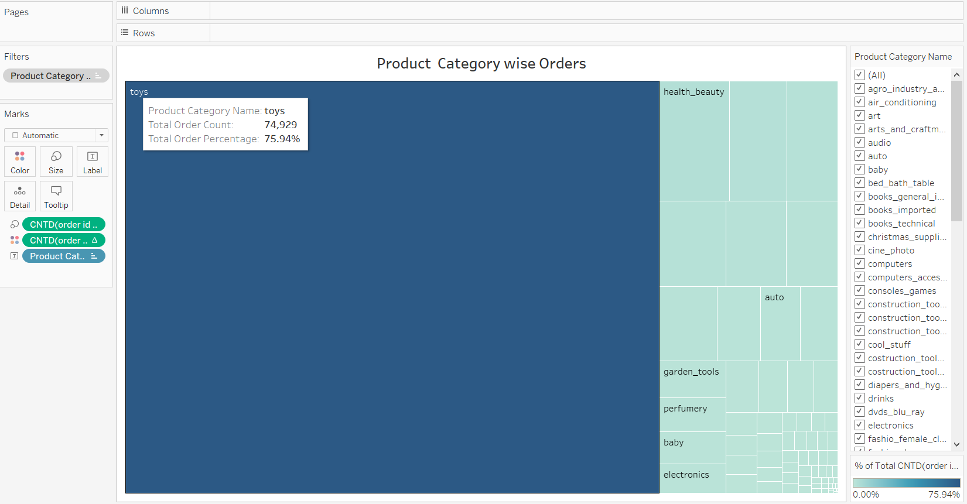
Product Category wise Orders
Visualizes product category wise total order count and percentage when the mouse is hovered over a particular product category
Using the filter on the right side, select a group of product categories to show their total order count & percentage of total among these categories
Toys have the highest order count & percentage

Slide 13
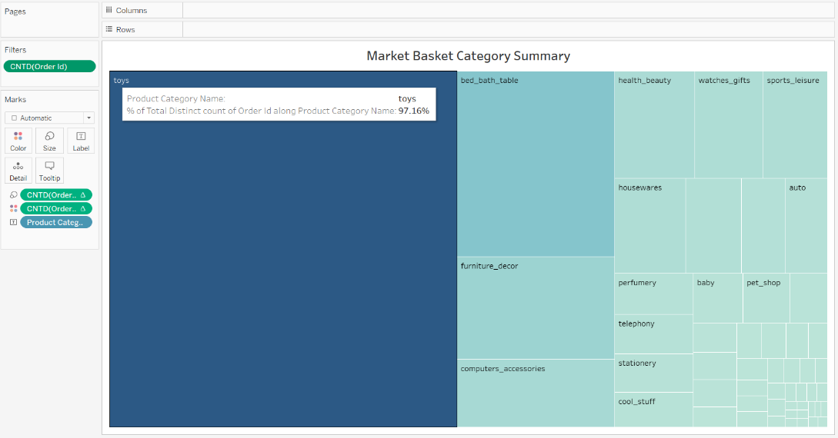
Market Basket Category Summary
Visualizes the total distinct count of orders along product categories when the mouse is hovered over a particular product category
Toys lead with the highest total distinct count of orders

Slide 14
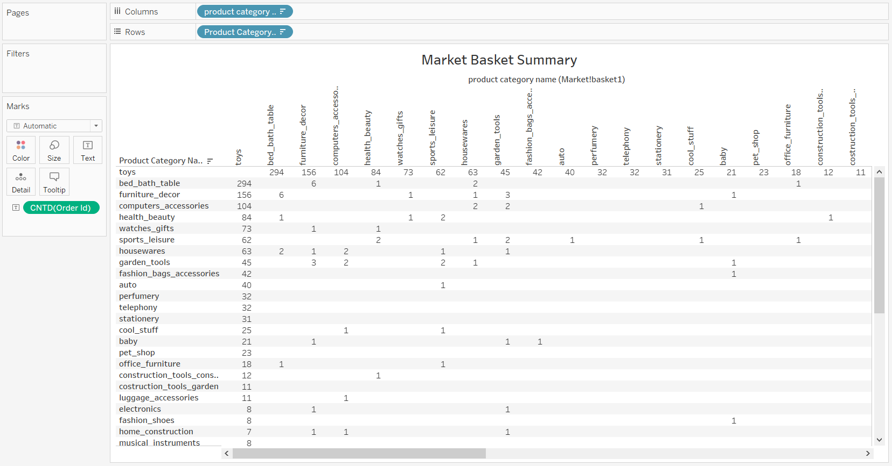
Market Basket Summary
Combinations of product categories which are frequently ordered together are visualized
Combination of products under ‘toys’ & ‘bed_bath_table’ categories are ordered highest number of times with a count of 294

Slide 15
Recommendations
Toys have the highest order count & percentage (~76%), so it is evident that this is a fast moving product category. Hence, the warehouse with toys will not incur much cost in terms of space & maintenance
Provide discounts & offers on purchase of Toys
In comparison to products with shelf life, toys are expected to last longer
Show recommendation of a toy purchase when baby products are added to cart. Even though this is not a insight from the provided dataset, customers who are intending to buy baby products might be interested in purchasing toys for their baby
High revenue & order based product categories to be focused more
Reduce the inventory of low demand products & remove such products from offering which have very low orders
Toys with bed_bath_table, furniture_decor & computer_accessories are frequently ordered together. So we can recommend shoppers to buy products under these categories who are planning to order Toys

Slide 16
Appendix – Data Assumptions
First assumption was that when an order is placed online there is very minimal time for it to get approved. So we have filled the missing values present under ‘order_approved_at’ column of the ‘orders’ table with its equivalent ‘order_purchase_timestamp’ values
Second assumption was that the order usually gets delivered very close to or on the estimated delivery date. So we have filled the missing values under ‘order_delivered_timestamp’ column of the ‘orders’ table with its equivalent ‘order_estimated_delivery_date’ values

Slide 17
Appendix – Data Methodology
We have made use of Tableau to get insights for our data analysis & visualization
Please find the detailed Methodology Documents by clicking here

Slide 18
Thank You!

